Slide 1
Pirate Way Motor Learning Lab
Emily Anderson and Karen Roof – Rock Hill School District 3
Information in the Powerpoint taken from WWW.abll.com and www.kidsfit.com

Slide 2
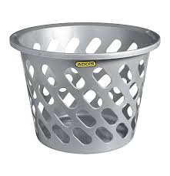
“Action Based Learning”
Next 10 slides from Action Based Learning Lab (www.abllab.com)
Their 3L mission: Continually striving to reach children who are Last in line, Lost in the school system, and deemed Least likely to succeed
Action Based Learning FILLS Developmental Gaps
Changing the future for all children by increasing their health, wellness, and education through movement

Slide 3
10 Developmental Foundations of Learning
Balance
We get information about where we are in space from our feet, not our seat. Balancing activities challenge the brain to adjust its spatial orientation using the proprioceptive system.
Balancing helps the brain to place words on a page, to read from left to right and to write patterns in sequence

Slide 4
10 Developmental Foundations of Learning
Cardio
Exercise benefits the brain by changing the brain at a molecular level. Since the brain does not produce it’s own fuel, it relies on cardiovascular exercise to pump oxygenated blood to the brain to use as fuel.
Physical Activity and exercise change the learning state to optimize retention and retrieval of memory

Slide 5
10 Developmental Foundations of Learning
Rhythm/Sequencing
The brain uses motor skills to lay the framework for learning. The brain’s cerebellum controls motor skills, agility and coordination.
Aids the brain in following the flow of words, sequencing patterns in math and reading, solving problems and sorting information

Slide 6
10 Developmental Foundations of Learning
Strength
Developing the muscular system provides support for the relay of messages throughout the central nervous system. Oxygen can then flow freely, supplying fuel to the brain.
Upper body and hand strength allows the students to write for longer periods.

Slide 7
10 Developmental Foundations of Learning
Cross Lateralization
When information moves from left to right and front to back in the brain, it crosses midlines which integrates the brain hemispheres and organizes the brain.
Cross lateralization movement aids the brain in placing words on a page, reading words from left to right and writing patterns in sequence

Slide 8
10 Developmental Foundations of Learning
Visual Tracking
Eye tracking exercises strengthen the muscles in our eyes to increase the length of time that eyes can focus for reading.
These concepts aid the brain encoding the stroke of each symbol of letters and numbers, following words from left to right and focusing on reading for longer periods

Slide 9
10 Developmental Foundations of Learning
Fine Motor Skills
35% of the brain’s motor cortex is dedicated to the use of the hands and the feet. The motor cortex helps the brain transfer what we are thinking to the paper.
Therefore, 35% of the brain’s ability to transfer information to the paper depends on good eye-hand, eye foot coordination

Slide 10
10 Developmental Foundations of Learning
Gross Motor Skills
The brain uses motor skills to lay the framework for learning. The brain’s cerebellum controls motor skills, agility and coordination.
These concepts aid the brain in following the flow of words, sequencing patterns in math and reading, solving problems and sorting information

Slide 11
10 Developmental Foundations of Learning
Vestibular
Activities that develop the vestibular system coordinate the auditory, visual and kinesthetic senses. Including spatial awareness, body control, dynamic balance, as well as locomotor skill development.
These concepts aid the brain in putting numbers or letters in sequence, discriminating different sounds, placing letters and words on a page and writing letters in proper proportions

Slide 12
10 Developmental Foundations of Learning
Proprioception
Proprioception is the body’s ability to sense itself, to sense movement within joints and joint position. It is often described as the concept of knowing where your body is in space (body awareness)
When we receive feedback/sensations from our joints and muscles this is considered proprioceptive input. We also obtain this input by lifting, pushing and pulling heavy objects

Slide 13
How to get administrators and classroom teachers on board-
It is imperative to get staff on board to make this successful. It may take more than a year but be vigilant and continue to share information like the picture to the left. The more we educate them about the benefits of movement on academics the more support you will receive.

Slide 14
What do we do?
Every Wednesday morning at 7:10, students will place their book bag in the classroom
Students should make sure they eat breakfast before joining and walking
Students will follow the walking pattern up and down each hallway until 7:30
At 7:30 students will continue the pattern until they get to their classroom

Slide 15
Let’s MOVE!
Walking Wednesday will allow our students to get moving before school day starts and get the brain ready to learn!

Slide 16
Math RTI
Incorporating Pirate Way Motor Learning Lab

Slide 17
Tier 2 Intervention
Strength
Balance
Look at Fall MAP scores to organize small groups
Students who fall below the 20th percentile will be group by their lowest area in math
Students will be pulled out for 20 minutes on Mondays to work in the motor lab
Activities will include 10 Fundamentals of Learning and Math focus in lowest area

Slide 18
Funding
Donors Choose- $800
Materials | Cost | Quantity | Total
Edubeam | $80.72 | 2 | $161.44
Stability Pads (6) | $121.83 | 1 | $121.83
Challenge Mat | $95.84 | 1 | $95.84
Mini Trampoline | $76.96 | 1 | $76.96
Duckwalkers (6) | $71.13 | 1 | $71.13
Soft Ring Toss | $19.73 | 1 | $19.73
Misc costs | $251.16 | Total | $798.09

Slide 19
Funding
Rock Hill School Education Foundation
Material | Cost | Quantity | Total
Green Rockin’ Turtle | $98 | 2 | $196
ABL Pathways Mat | $525 | 1 | $525
Pattern Walking Mat | $545 | 1 | $545
Total Grant |  |  | $1,500

Slide 21
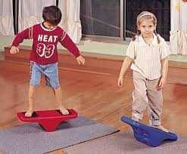
Balancing helps the brain to place words on a page, to read from left to right and to write patterns in sequence. Activities that involve balancing aid the brain in anchoring information and improved memory retrieval.

Slide 22
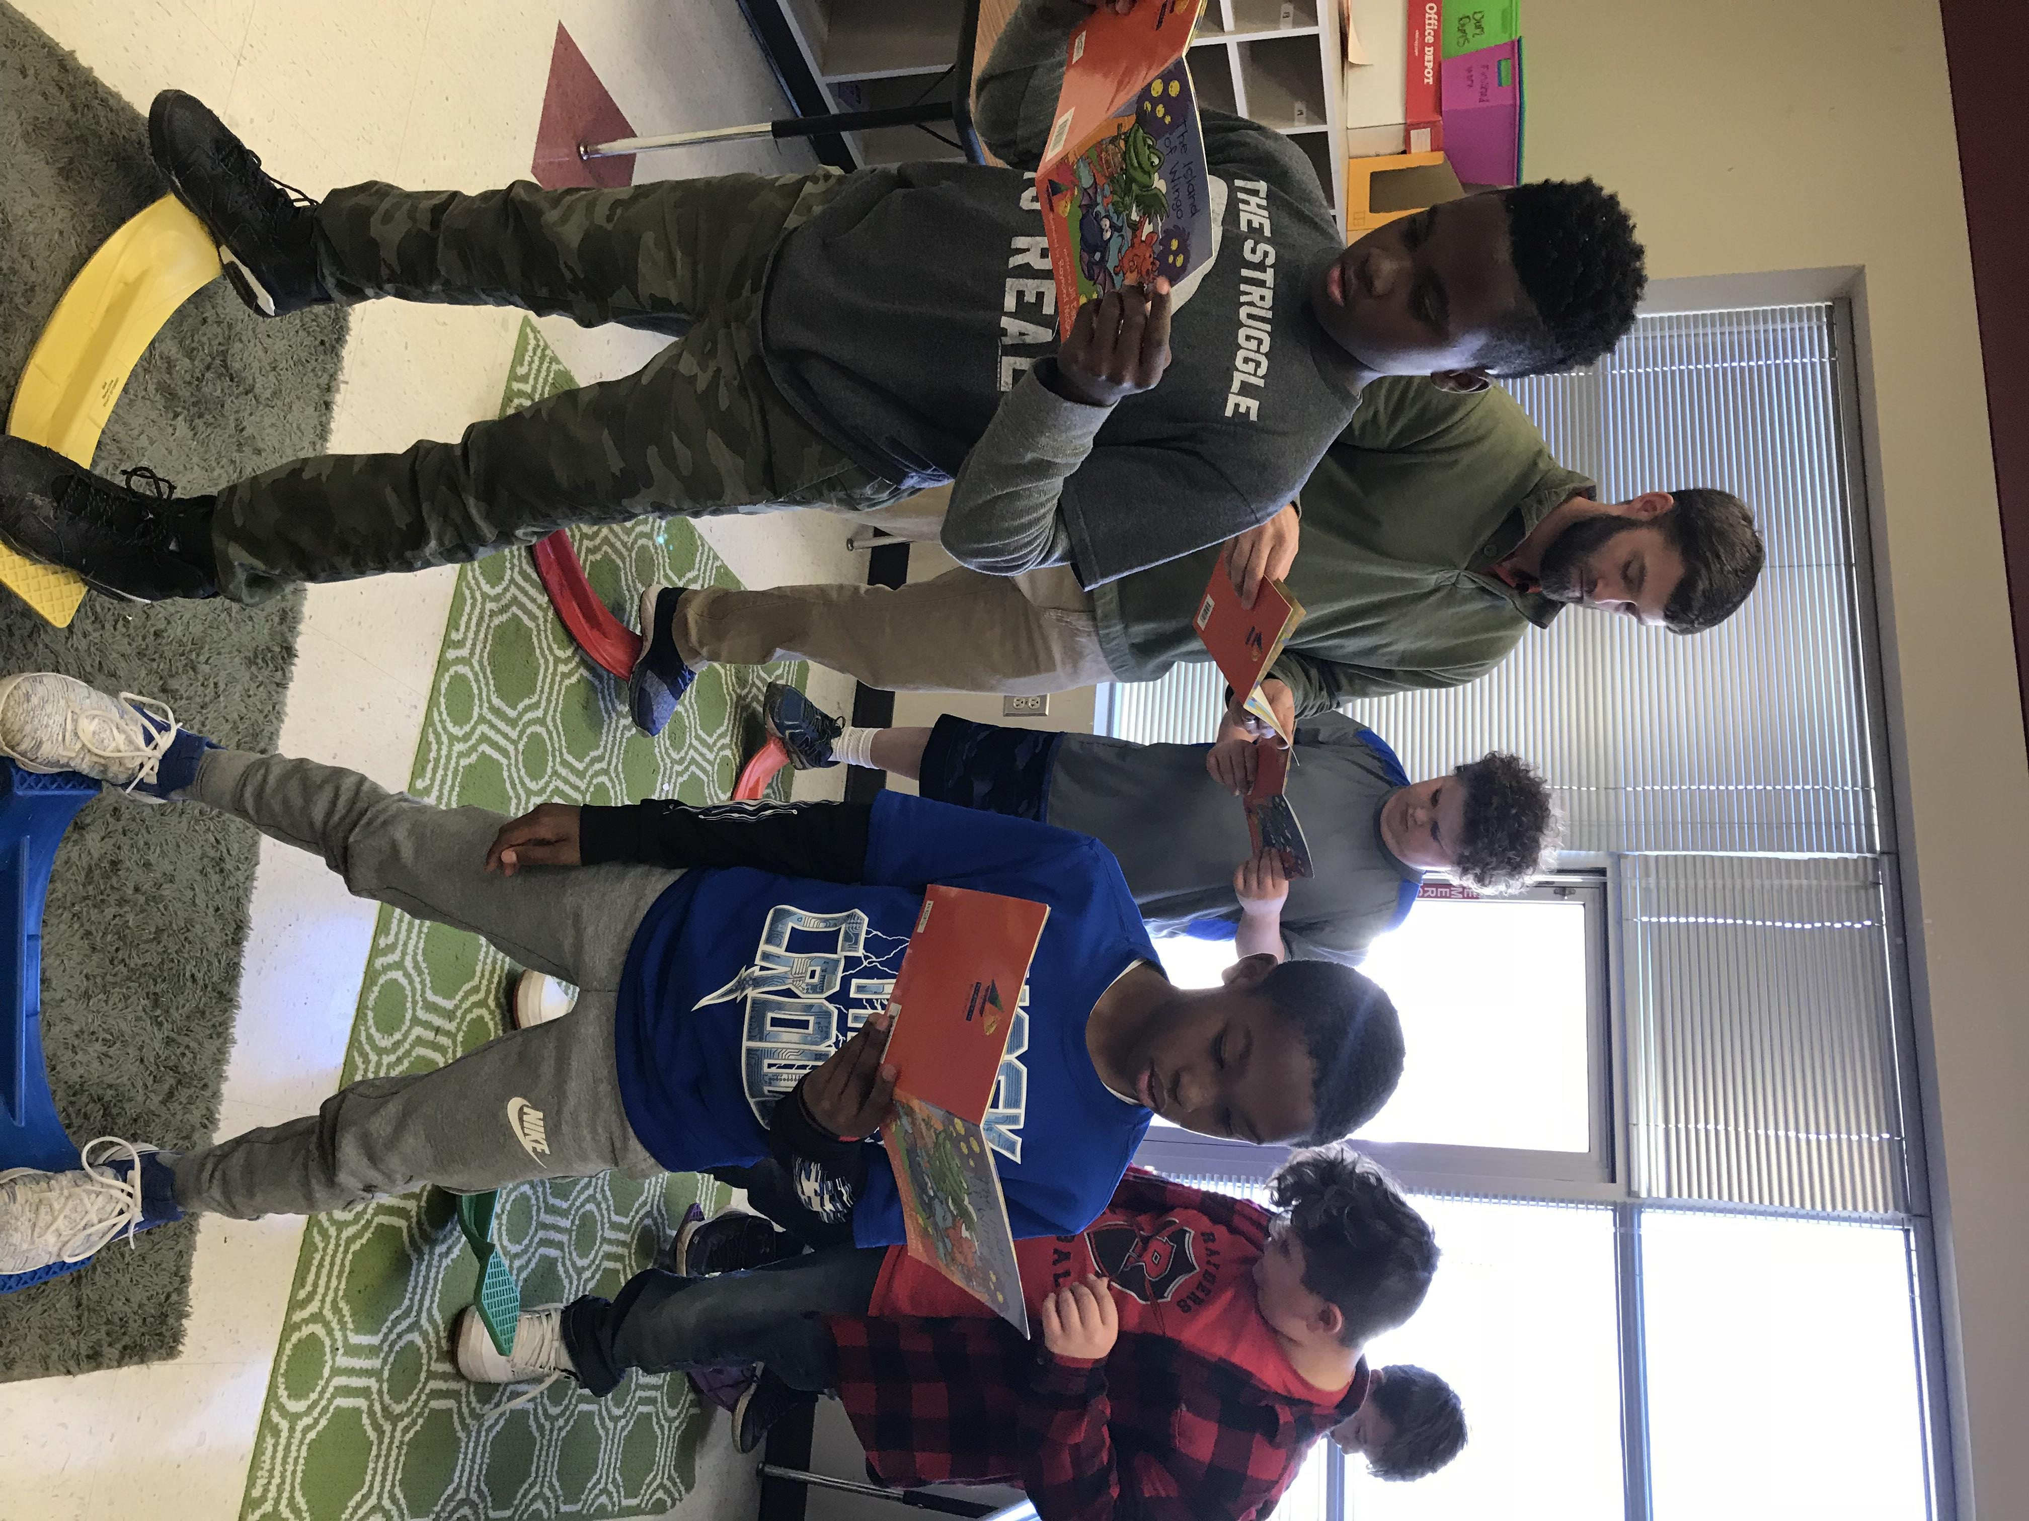
These balancing activities can be used for reading or math.

Slide 23
Balance Beam activities
Aids in improving memory retrieval- (i.e. preparation to take a test and combining skills to promote higher level thinking)

Slide 24
Visual Tracking
Visual tracking helps students read from left to right and up and down. It is an important skill used in reading.

Slide 25
Vestibular System
Rocking motions stimulate the vestibular system (the system that allows us to move smoothly and efficiently)
The vestibular system helps with tasks that require the eyes to move left to right (reading) or up and down repeatedly (copying from the board) Rocking improves gross motor control and promotes social interaction and teamwork.

Slide 26
Crossing the Midline
Walking on the mat allows the student to cross the midline of the brain and body. This helps to organize the brain, integrate the brain’s hemispheres and energize the brain to enable it to put thoughts into action.

Slide 27
Cardio
Increasing blood flow to the brain through exercise gives more oxygen for the brain and enhances learning and retention.

Slide 28
Balance and brain connection
When students balance and look at numbers or words, they will strengthen brain connectivity between brain hemispheres by stimulating the vestibular ocular reflex. This is the body’s ability to maintain clear visual focus during movement. Assists with reading skills, ability to focus on words on a page, eye-hand coordination by improving spatial awareness. Helps with handwriting skills to maintain space between letters.

